Slide 1
GLOBAL CIRCULATION
The Solution To The Latitudinal Radiation Imbalance

Slide 2
Atmospheric Circulation
The Single-Cell Model
An OVERLY simplified model of Atmospheric Circulation
Proposed by British Physicist George Hadley in 1735
Makes Several Assumptions:
Earth is NOT rotating
Earth surface IS homogeneous
Equator receives most insolation
Poles receive least insolation

Slide 3
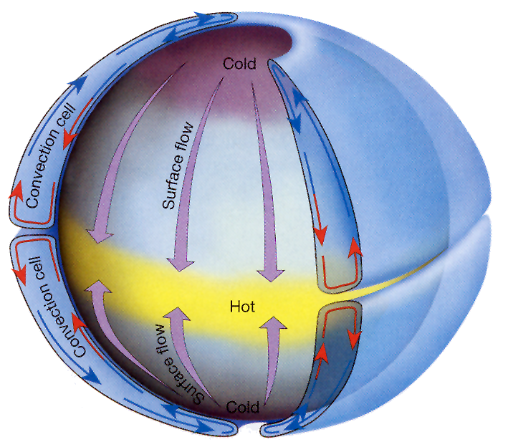
Cold Air Sinks At The Poles
Warm Air Rises At The Equator
Cold Air Sinks At The Poles

Slide 4
Thermal High
Thermal Low
Thermal High

Slide 5
Atmospheric Circulation
The Three-Cell Model
Divides the circulation of each hemisphere into three distinct cells:
Hadley Cell
Ferrel Cell
Polar Cell
Proposed by American Meteorologist William Ferrel in the 1800’s

Slide 6
Atmospheric Circulation
The Three-Cell Model (Cont.)
Also Makes Several Assumptions:
Earth IS rotating
Earth surface is homogeneous
Equator receives most insolation
Poles receive least insolation

Slide 7
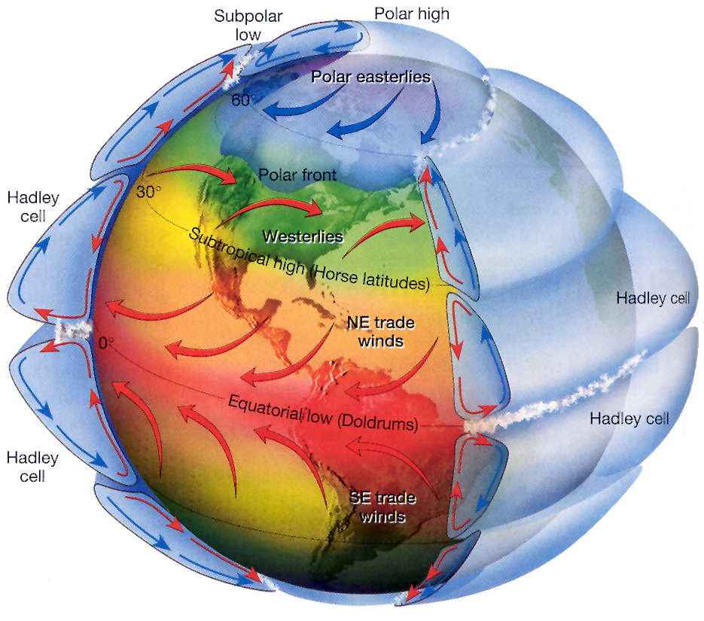
Thermal High
Thermal Low
Thermal High

Slide 8
Thermal High
Air Rises To The Top Of The Troposphere
Diverges & Heads To The Tropics
Thermal High

Slide 9
Thermal High
ITCZ:
Latitude Dominated By Heavy Rain
Thermal High

Slide 10
Dynamic High:
Due To The Earth’s Rotation, Air Sinks at approx. 30 °N/S
Thermal Low
Dynamic High
Thermal High

Slide 11
Little Cloud/ Precipitation
Low PGF, Thus Little Surface Winds
Thermal Low
Dynamic High
Thermal High

Slide 12
Upon Reaching The Surface, Air Diverges.
Thermal Low
Dynamic High
Thermal High

Slide 13
Some Air Returns To The Equator
Completing The Hadley Cell
Thermal Low
Dynamic High
Thermal High

Slide 15
The Rest Heads Poleward!
Thermal Low
Dynamic High
Thermal High

Slide 16
This Air Meets, & Converges With Air Coming From The Poles at approx. 60 °N/S
Thermal Low
Dynamic High
Thermal High

Slide 17
Convergence Forces Air Aloft, Creating A Dynamic Low
Thermal Low
Dynamic High
Dynamic Low
Thermal High

Slide 18
Clouds, Precipitation & High Winds Associated With Low Pressure
Thermal Low
Dynamic High
Dynamic Low
Thermal High

Slide 19
Air Diverges Both North & South
This Completes The Ferrel Cell & Polar Cell
Thermal Low
Dynamic High
Dynamic Low
Thermal High

Slide 20
Atmospheric Circulation
The Three-Cell Model (Cont.)
Review/Implications:
0°/ITCZ/Equatorial Low
zone of clouds and frequent rain
30°N & S
zone of aridity: deserts
60°N & S
zone of stormy weather, fronts, unpredictable, rain or snow
Poles
also deserts:
very little actual snowfall

Slide 21
Atmospheric Circulation
Named (Surface) Winds
People experience winds at the surface
So these are given names
Winds are ALWAYS named for the direction of their ORIGIN
from which direction they are coming

Slide 22
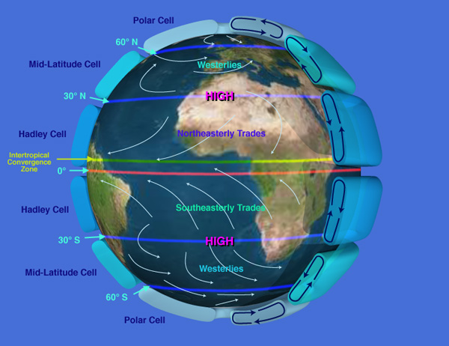
Surface Winds…
PGF: Deflected To Right (Weakly)
PGF: Deflected To Left (Weakly)

Slide 23
Surface Winds…
PGF: Deflected To Right (Strongly)
PGF: Deflected To Left (Strongly)

Slide 24
Polar Easterlies
PGF: Deflected To Right (Strongly)
PGF: Deflected To Left (Strongly)
Polar Easterlies

Slide 26
Atmospheric Circulation
Jet Stream
Relatively narrow bands of strong wind in the upper Troposphere
Meandering ‘freeways’ of air
Wind speeds average
180 km/hr (110 mph) in winter
(Strong Cat 2 Hurricane)
60 km/hr (37 mph) in summer
Strongest winds can exceed 360 km/hr (223 mph)
(Cat 5 Hurricane > 155 mph)

Slide 27
Atmospheric Circulation
Jet Stream Formation
Recall that winds are strongest wherever Pressure Gradient Force is greatest
i.e. Wherever there is a dramatic change in pressure/temperature
As we have seen, such transitions take place at the intersection of both:
The Hadley and Ferrel Cells, and
The Ferrel and Polar Cells

Slide 28
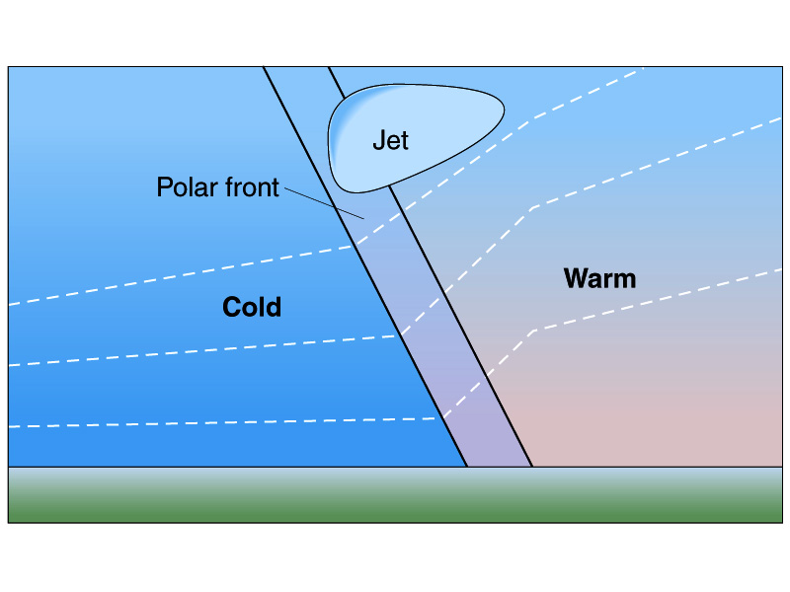
Steep Pressure Gradient Causes Extremely Fast Winds
300 mb
500 mb
700 mb
1000 mb
40 °F
45 °F
75 °F
80 °F
Fig 8-8

Slide 29
Atmospheric Circulation
Jet Stream Formation (Cont.)
There is another factor at play here:
The Conservation Of Angular Momentum
Recall that the Earth (and all locations upon the earth) rotates once per day!
This means that during the course of any day, lower latitudes (like the Equator) have further to travel than higher latitudes (like the poles)
Thus lower latitudes rotate faster than higher latitudes!

Slide 30
Atmospheric Circulation
Jet Stream Formation (Cont.)
When a parcel of air leaves the ground at a low latitude, its eastward momentum (speed) remains constant as it travels poleward.
Note: This means upper level winds will be coming from the WEST. Thus they are called westerlies
Thus, the further poleward the parcel goes, the greater its eastward momentum is in comparison to the surface beneath it.
These speeds are then accentuated by the strong PGF described before.

Slide 31
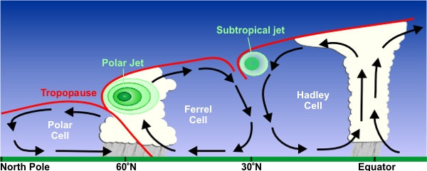
There are 2 Jet Streams in Each Hemisphere:
Polar Jet Stream – Where the warm subtropical winds of the Ferrel Cell meets the cold winds of the Polar Cell (High PGF)
Subtropical Jet Stream – Where poleward bound Equatorial winds reach their greatest velocity at the boundary between the Hadley and Ferrel Cells.

Slide 32
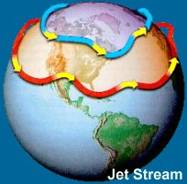
Atmospheric Circulation
Jet Stream
The Polar & Subtropical Jet Streams flow from west to east (westerlies) around the world!
Recall that, they’re strongest in winter when the difference in temperature is greatest.
Their paths are NOT fixed!
They migrate with the frontal boundaries.

Slide 33
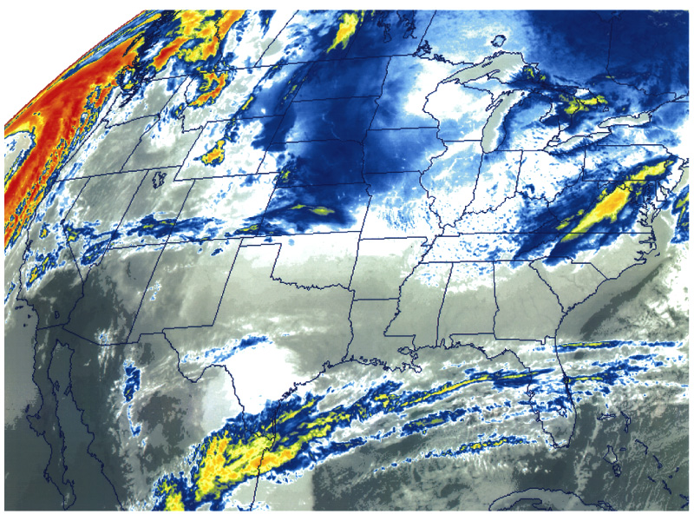
Here, the migrating Subtropical Jet Stream carries moisture from the Equator to Mexico & Florida

Slide 34
Atmospheric Circulation
Reality Check: Where does the 3-Cell model fail?
Yes, Earth IS rotating
No, Earth surface is NOT homogeneous
Land-sea heating differences, topography & Seasons
No, the Equator does NOT receive the greatest amount of insolation
Arid zones (Deserts) do. Seasons & No clouds!
Yes, the Poles DO receive the least amount of insolation

Slide 35
Atmospheric Circulation
Reality Check (Cont.):
If the Equator truly was the area of greatest insolation, then we would expect the ITCZ to constantly reside there
However, we have seen that the arid deserts are the area of greatest insolation.
Furthermore, we know that Continents warm (and radiate) faster than Oceans.
Thus the ITCZ (and its life giving rains) follow the ‘Thermal Equator’ (the warmest latitude)
Closer to 0° over the oceans
but seasonally at higher latitudes over land

Slide 36
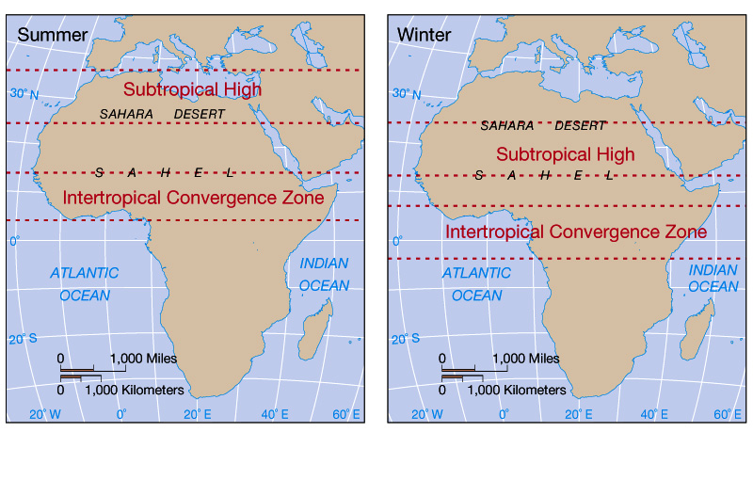
Fig. 8-5
The Sahel borders the southern Sahara Desert. In the Summer, the ITCZ migrates north with the ‘Thermal Equator’. This gives the region a brief rainy period.

Slide 37
Seasonal Pressure and Precipitation Patterns
Notes:
To view this animation, click “View” and then “Slide Show” on the top navigation bar.

Slide 38
Atmospheric Circulation
Reality Check (Cont.):
Semi-permanent Pressure Cells
Highs & Lows do not occur in continuous bands, but as:
‘Semi-permanent Pressure Cells’
These cells are not fixed at 30° & 60° N & S, but move north and south with the seasons
The intensity of the pressure in each cell also varies with the seasons

Slide 39
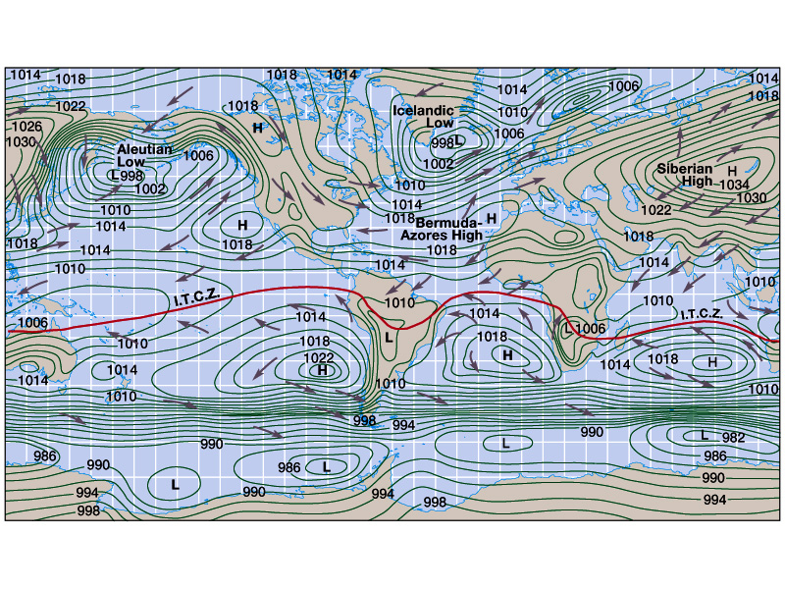
Fig. 8-4a: January

Slide 40
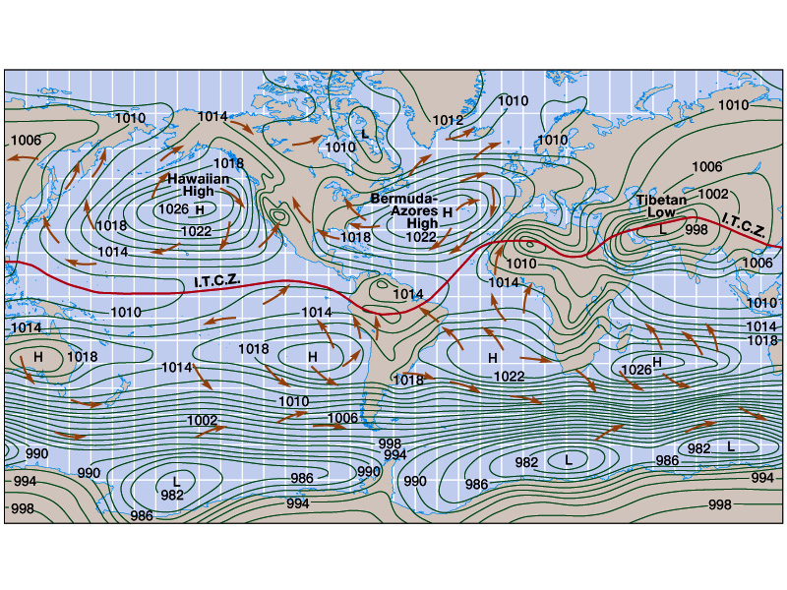
Fig. 8-4b: July

Slide 41
Fig. 8-4a: January

Slide 42
Fig. 8-4b: July

Slide 43
Fig. 8-4a: January

Slide 44
Fig. 8-4b: July

Slide 45
Fig. 8-4a: January

Slide 46
Fig. 8-4b: July

Slide 47
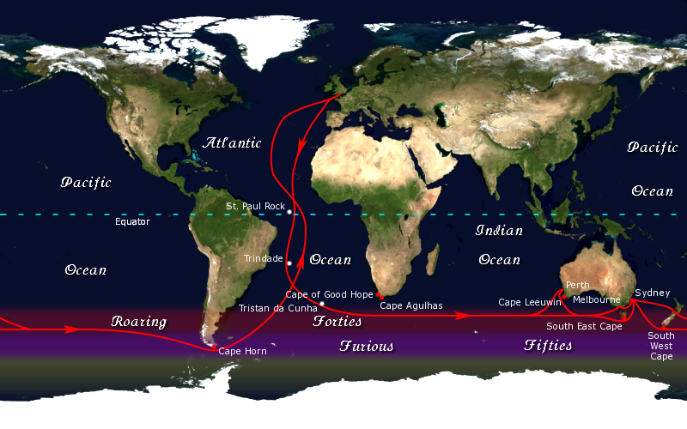

Slide 48
Atmospheric Circulation
Reality Check (Cont.):
Recall that these cells and the ITCZ will migrate with the seasons!
Thus we would expect the ITCZ to reach its:
northernmost point during the June Solstice
southernmost point during the December Solstice
And rest over the Equator during the Equinoxes
If we think back to the 3-Cell model, this is analogous to…
the Cells being a ‘socket’ that sits upon the plane of the ecliptic, and
The Earth being a ‘ball’ rotating in the socket with the changing seasons

Slide 50
Atmospheric Circulation
Reality Check (Cont.):
Deserts do not only occur at 30° & 90° N & S
Although they do tend to straddle the Tropics
They are most common on the western side of continents
They also occur in the middle of continents where rainfall is low
And they occur in ‘rain shadow’ areas
Polar deserts do exist

Slide 51
Oceanic Circulation
Surface Winds cause the surface of the ocean to move
Creating ocean currents
This affects only the top layers of the oceans
About 10% of water in oceans
Other factors that influence ocean currents are:
Coriolis Force and
Land Masses
Currents are warm or cold depending on their latitude of origin

Slide 52
OCEANIC CIRCULATION
The Trade Winds cause oceans to flow from E to W along the equator:
0°

Slide 53
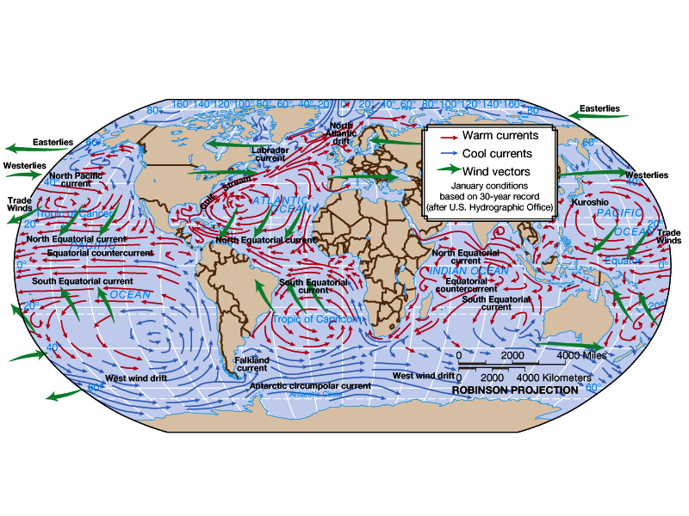
Fig. 8-15

Slide 54
Oceanic Circulation
When they hit a land mass they are diverted, and
The Westerlies continue their flow
0°

Slide 55
Oceanic Circulation
When they hit another land mass, they curve back around and flow back to 0°
0°

Slide 56
Oceanic Circulation
Such motion is called a GYRE
Currents moving from:
Low latitudes to high are WARM;
those moving from high to low are COLD
Examples of warm currents:
Gulf Stream,
Kuroshio Current
Examples of cold currents:
Labrador Current,
Peru Current

Slide 57
Oceanic Circulation
Ocean current temperature influences rates of evaporation.
Warm currents evaporate more water than cold, and thus provide more moisture for rain.
Land alongside a warm current is more likely to be wet.
Deserts are most common on the western side of continents,
Due to the fact that this is where cold currents flow

Slide 58
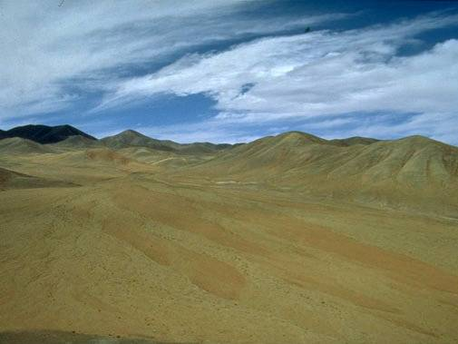
Atacama Desert – Chile The Driest place on Earth

Slide 59
Oceanic Circulation
What happens to the other 90% of the ocean?
Currents do occur, but they are not controlled by the wind
Salty water is more dense, so it sinks
Cold water is more dense, so it sinks
This creates deep water salinity or density currents

Slide 60
Oceanic Circulation
The Great Ocean Conveyor
a.k.a. Thermohaline Circulation
Driven by differences in the density of sea water which is controlled by:
temperature (thermal) and
salinity (haline)
As water flows north in the Atlantic it cools (making it more dense)
This water will ultimately freeze.
However, the salts in this water do not freeze.
Instead, they are left behind with the unfrozen water (making it more dense)
Upon sinking, this dense water flows south and ultimately around the world.

